Slide 1
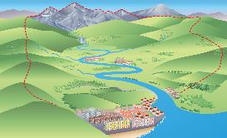
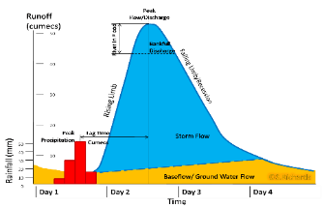
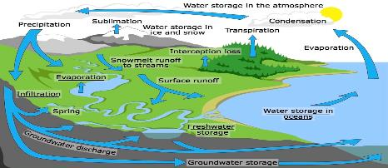
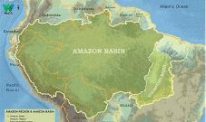
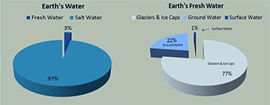
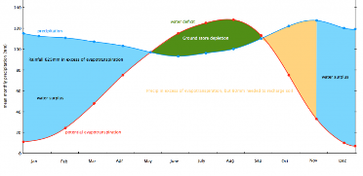
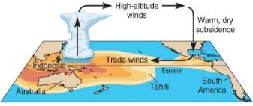
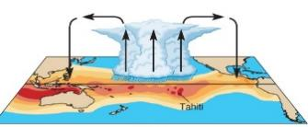
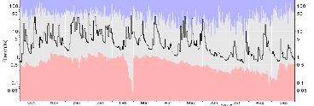
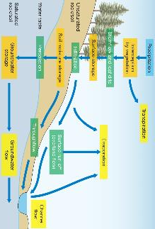
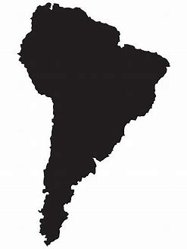
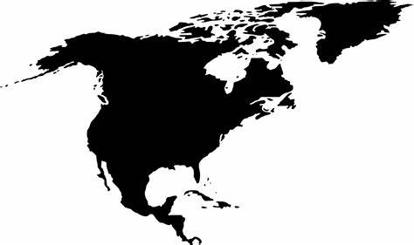
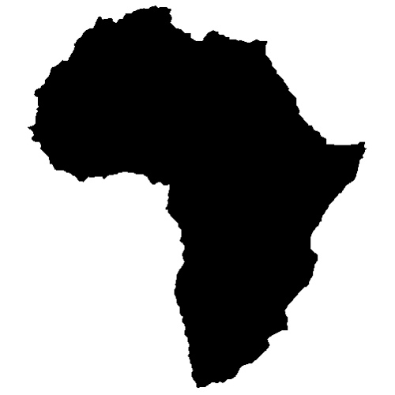
The Hydrological Cycle
The hydrological cycle is a closed system. This means no water is added to the global budget and none is removed. The system is driven by solar energy and gravitational potential energy.
STORE | FLUXES | FLOWS
These are reservoirs where water is held, such as oceans. | This measures the rate of flow between the stores. | The transfer of water from one store to another.
Drainage Basin
A drainage basin is an area of land drained by a river and its tributaries.
The boundary of the drainable basin is defined by the watershed (the highland which divides and separates water flowing to different rivers). Drainage basins can be any size, from a small stream to major rivers across international boundaries. This is important as drainage basin size can influence the length and the amount of discharge held in a river basin.
Human Impacts on the Drainage Basin
Dams can be built to generate hydro-electric power and fresh water supplies. | Urbanisation can increase surface runoff and water usage. | Rivers can be diverted for irrigation in agriculture. | Deforestation or afforestation can change storage levels. | Abstraction of water for domestic/industry reduces flows.
Physical Impacts on the Drainage Basin
Climate has a role in influencing the type and amount of precipitation. Also it influences the amount of evaporation. | Soils determine the amount of infiltration and throughflow directly and indirectly. Also types of vegetation. | Geology can impact on subsurface processes such as percolation and groundwater flow. | Relief can impact on the amount of precipitation. Slopes can affect the amount of runoff. | Presence/absence of vegetation can impact interception, infiltration, overland flow and transpiration.
Storm Hydrographs and River Discharge
River discharge is the volume of water that flows in a river. Hydrographs show discharge at a certain point in a river changing over time in relation to rainfall
Peak discharge is the discharge in a period of time.
Lag time is the delay between peak rainfall and peak discharge.
Rising limb is the increase in river discharge.
Falling limb is the decrease in river discharge to normal level.
Factors affecting the Shape of a Storm Hydrograph
Shape Circular basins have shorter lag times when compared to elongated basins which have longer lag time. | Topography Steep slopes promote surface runoff, whereas gentle slopes allow for infiltration and percolation. |  | Vegetation Deciduous trees in winter means low levels of interception than compared to the summer. This also causes more evaporation.
Soil Clay has low infiltration rates when compared to sandy soils which have a much higher infiltration rate. | Geology Impermeable rocks, such as granite, restricts percolation and increases surface runoff in comparison to limestone. |  | Human activity Urbanisation has impermeable (concrete and tarmac) surfaces. Natural landscapes will have fewer of these surfaces.
Storm Hydrographs and Players
Urban planners will aim to manage the impacts of flood risks due to populations being in proximity to rivers. Therefore planners will explore options such as strengthening embankments, implementing emergency procedures and avoiding any new developments on known floodplains.
The Global Water Cycle
Water largely exists as vapour in the atmosphere. Clouds can contain liquid water or ice crystals.
In the cryosphere water is largely found in a solid state, with some liquid form as melt water and lakes.
On the land water is stored in rivers, streams, lakes and groundwater in liquid form. | Water is also stored in vegetation or in the soil. | In the oceans the vast majority of water is stored in liquid form, with only a minute fraction held as icebergs.
The Global Water Budget
The table shows residence times. This is an average time a water molecule will spend in the reservoir or store. Residence times can impact on the turnover within the water cycle system.
STORES | Volume (10³ km²) | % of total water | % of fresh water | Residence time
Oceans | 1,335,040 | 96.9 | 0 | 3,600 years.
Icecaps | 26,350 | 1.9 | 68.7 | 15,000 years.
Groundwater | 15,300 | 1.1 | 30.1 | Up to 10,000 years.
River and lakes | 178 | 0.01 | 1,2 | 2 weeks to 10 years.
Soil moisture | 122 | 0.01 | 0,05 | 2-50 weeks
Atmospheric moisture | 13 | 0,001 | 0,04 | 10 days
CASE STUDY: Amazon Drainage Basin
The Amazon basin is the world’s largest at 6 million km². The basin contains the world’s largest area of tropical rainforest. The climate experiences high precipitation rates and average temperatures, with little seasonal differences. Around 50-60% of precipitation in the Amazon basin is recycled by evapotranspiration.
The rainforest’s trees play a crucial role in the water cycle. This is done by absorbing and storing water from the soil & releasing it through transpiration. However, recent deforestation has disrupted the drainage basin cycle with: Less precipitation More surface runoff and infiltration More evaporation, less transpiration More soil erosion and silt being fed into the rivers.
Types of Drought
Meteorological drought | This happens where long-term precipitation is lower than normal. It changes for different regions as it is affected by the atmospheric conditions.
Agricultural drought | This happens when there is not enough soil moisture to allow enough crops to grow. It is caused by precipitation shortages, changes in rates of evapotranspiration and reduced groundwater levels.
Hydrological drought | This happens when the amount of surface and subsurface water (rivers, lakes, reservoirs and groundwater) is deficient. It is caused by a lack of precipitation and usually occurs after meteorological and agricultural drought.
Socio-economic drought | This occurs when water demand outstrips the water availability. This could be caused by a lack of precipitation or by human overuse of water sources.
Physical Systems and Suitability: Water Cycle & Water Insecurity
Accessible Water for Human Life
Overwhelmingly, 97% of water is stored in the oceans, with only 3% as fresh water. 77% of this fresh water is inaccessible and is locked in ice sheets, ice caps and glaciers found in the high latitude and altitude locations. Another 22% is groundwater, therefore leaving only 1% being easily accessible for humans.
The Water Budget
This is the annual balance between inputs (precipitation) and outputs (the channel flow and evaporation).
The water budget shows the times when water naturally enters and leaves the system: When there is more than enough water (this is called a positive water balance). When there is not enough water (this is called a negative water balance). This is useful as it shows times for a potential drought. A drought would create challenges to human consumption, agriculture, health etc.
 | Equation to calculate a water budget: Precipitation (P) = channel discharge (Q) + evapotranspiration (E) + change in storage (S)
Physical Causes of Drought: El Nino Effect
El Nino can trigger very dry conditions throughout the world, especially in Australia and Indonesia. The dry conditions causes weak rains and monsoon failure in India and SE Asia.
 | Normally, warm ocean currents off the coast of Australia cause moist warm air (low pressure) to rise and condense causing storms and rain over Australia.
In an El Niño year (every 2-7 years) the cycle reverses. Cooler water off the coast of Australia reverses the wind direction leading to dry, sinking air (high pressure) over Australia. This creates hot weather and a very low amount of rainfall.
Sometimes following an El Nino event are La Nina episodes. They involve the build up of cooler than usual subsurface water in the tropical part of the Pacific. This reversal can lead to severe droughts in western parts of South America and wet conditions in Eastern Australia.
Types of Water
Blue Water | Green Water | Fossil Water
Blue water is the amount of rainfall water that ends up in rivers, lakes, reservoirs and groundwater. | The green water is the amount of rainfall that falls on vegetation, enters the soil and gets used by the vegetation. | This is an ancient body of water that has been contained in an undisturbed space, typically groundwater for millennia.
The Drainage Basin Water Cycle
On a smaller scale the drainage basin is a subsystem within the global hydrological cycle. It is an open system as it has external inputs and outputs that cause the amount of water in the basin to vary overtime.
Input |  | Flows | Stores |  | Outputs
Groundwater Storage | Water which is stored underground in permeable rocks. e.g. aquifers.
Precipitation | Moisture falling from clouds as rain, snow or hail.
Interception | Vegetation prevents water reaching the ground.
Surface Runoff | Water flowing over surface of the land into rivers.
Infiltration | Water absorbed into the soil from the ground.
Percolation | When water moves downwards through the soil.
Transpiration | Water lost through leaves of plants.
Through Flow | When rainfall or water flows through the land.
Evaporation | The process in which a liquid changes state and turns into a gas.
River Regimes
This is the annual variation in the discharge or flow of a river at a particular point. It is measured using cumecs.
The main factors that affect the regime of the river are: Drainage basin area Temperatures, with possible meltwater and high rates of evaporation in the summer. Variation in altitude Geology and soil, particularly their permeability. Mean annual precipitation and discharge rates. Main land use, such as urbanisation or forests. Human activities aimed at regulating a river’s discharge such as dams. | The highest flow is shown by the bottom of the blue coloured area. | The lowest flow is shown by the top of this red coloured area.
CASE STUDIES: Different River Regimes
Amazon River South America | Yukon River North America | River Nile Africa
Humid tropical climate based by ancient shield rock. Peak discharge in April-May and-lowest in September. Linked to wet and dry seasons and Andean snowmelt. | Tundra climate which flows through a mountain range. In winter the temperature drops so water freezes. In summer, meltwater is a sudden input into the system. | Warm, arid climate. Huge drainage basin. In 1970, the Aswan Dam significantly altered the regime. Flow reduced by around 65% and the seasonal flow was changed.
Human Activity on Drought
Agriculture | Dam Construction | Deforestation
Using large amounts of water to irrigate crops can remove water stored in lakes, rivers and groundwater. Some crops require more water than others. Finally, overgrazing can destroy vegetation cover. | Large dams can be built across a river to produce electricity and store water in a reservoir. This can reduce river water naturally flowing downstream. This can create drought conditions downstream from the dam. | This can reduce the amount of water stored in the soil as rain tends to fall and wash off the land as surface run-off. This causes the ground to become vulnerable to erosion and desertification.

Slide 2


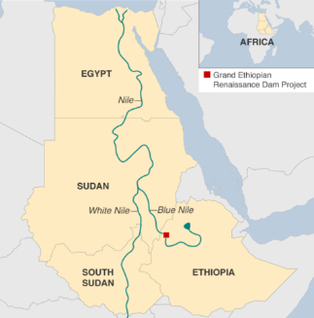





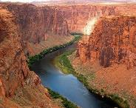
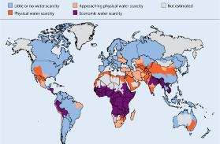
Ecological Impacts of Drought
Wetlands | Forests | Desertification
A deficit of water can lead to the drying out of wetland habitats. Since such habitats support a great variety of flora and fauna, the survival of all these life forms becomes difficult when there is a deficit of water. | The absence of precipitation and dry foliage. If temperatures are high, this foliage can catch fire. Wildfires are highly common during droughts. In the absence of rainfall to extinguish any fires, wildfires can destroy vast areas. | Droughts can accelerate desertification caused by overgrazing, deforestation, and other human activities. The lack of water further kills plants, leaving little chance for the land to recover.
Wildlife Migrating | Biodiversity | Dust Storms
The lack of water and food during droughts forces wildlife to migrate to where vital resources are available. However, many animals die during such journeys. Those reaching better habitats often die after failing to adjust. | Most plants and animals living in areas that are experiencing severe drought are unable to survive. As a result, entire populations of a species can be wiped out from an area. Thus, drought-affected areas exhibit a great loss of biodiversity. | In the absence of water, soil dries up and becomes susceptible to wind erosion. Thus, droughts often trigger dust storms, which in turn negatively affects the plant and animal life. Dust storms can also affect human health.
Impact of Climate Change on the Hydrological Cycle
The International Panel of Climate Change predict that as a result of increased greenhouse gas emissions, there will be considerable changes to the inputs, outputs and stores within the hydrological cycle.
Increasing convection and evaporation. | Increased condensation and cloud cover. | Increased precipitation in the tropics and mid-latitudes.
Decreased snow, permafrost and ice cover. Increase in meltwater will increase river flooding. | Decreased humidity and precipitation in certain locations e.g. subtropics. | Less accumulation of glacial ice because more precipitation is falling as rain.
Increase in high-pressure systems. | Increased flood risks in the tropics and mid-latitudes. | Increasing incidence and severity of drought events.
Water Conflicts
When the demand for water overtakes the available supply and there are key stakeholders desperate for that water, there is potential for conflict, otherwise known as ‘water wars’.
CASE STUDY: Nile River Conflict
Location and Background
Located in Africa, the Nile is the world’s longest river (6,700km) and no less than 11 countries (e.g. Sudan, Egypt, Ethiopia and South Sudan) and 300 million people are competing for its water. Importantly, many of these countries are amongst the poorest in the world.
Issues and Concerns
Egypt is entirely dependent on the Nile for its water supply. They regard any reduction as a national security issue and against the agreements of 1959 Nile Water Treaty. With the construction of dams downstream in Ethiopia (such as the Gran Renaissance Dam on the Blue Nile) a potential flash point has emerged due to the possibility of a reduction in annual flow. Both Egypt and Ethiopia has seen rapid population growth and seek to become more economically developed. Therefore access to safe and sufficient water will be critical in the future.
Climate Change Future Trends – more rain and more drought
2010 was the wettest year ever recorded; heavy precipitation increased the incidence of flooding. Economic losses from hydrological disasters have grown quickly. Flood figures do not show an upward trend of flooding, however they do show more extremes. Droughts have become more widespread and severe. More intense droughts have affected more people. ENSO also plays a role; This can destabilise atmospheric conditions and set the stage for the increase in precipitation and flooding events.
Ecological Resilience
The capacity of an ecosystem to withstand and recover from a natural event or human disturbance.
CASE STUDY: Drought in Australia (The Big Dry) 2006
Causes
Drought in Australia is often caused by a weather pattern in the Pacific Ocean known as El Niño. In an El Niño year (every 2-7 years) the cycle reverses. Cooler water off the coast of Australia reverses the wind direction leading to dry, sinking air (high pressure) over Australia causing hot weather and a lack of rainfall.
Short-term Effects | Long-term Effects
Urban areas suffered a major water shortage. Critical reservoirs dried up. Crop failure and dried vegetation. Animals die from starvation and dehydration. | Crop failure led to financial losses for farmers Suicide rates amongst farmers soared. Number of sheep in Australia fell by 6 million. Vegetation loss and soil erosion lead to rivers and lakes suffering with outbreaks of toxic algae.
Short-term Management | Long-term Management
Water conservation measures were introduced. The 3 million people who rely on the River Murray for their water allocation reduced. The Australian government provided over 23,000 rural families and 1500 small businesses with income support. | Investment into improving drought forecasts so that farmers can prepare better, improving irrigation systems, and drought resistant crops. Large-scale recycling of grey water. Construction of desalinisation plants and devising new water conservation strategies.
Water Insecurity
This is defined as the lack of a reliable source of water, of appropriate quality and quantity to meet the needs of the local human population and environment.
Water Stress | Water Scarcity | Absolute Water Scarcity
When demand for water is greater than the amount of water available (1,000-1,700m³ per capita) , and when water is of poor quality and restricts usage. | Water scarcity is the lack of sufficient available water resources (500-1,000m³ per capita) to meet the demands of water usage within a region. | When renewable water resources are extremely low (less that 500m³ per capita) then there is widespread restriction on use.
Managing Water Supply
Hard Engineering Methods of Water Supply
These projects involve high levels of capital and technology. However, these projects have various questions as to their environmental and social costs.
Water transfer schemes | Mega dams | Desalination
This involves the diversion of water from one drainage basin to another. | Large rivers are impeded, stored, rechanneled and re-engineered to redesign the natural flow. | Converts saltwater from the oceans into useable freshwater on a large scale
Example: The South-North water Transfer project, China. | Example: The Three Gorges Dam, China | Example: Israel, Saudi Arabia and Australia
Sustainable Methods of Water Supply
This is using methods that are more natural or minimizing wastage and pollution of water resources. It also aims to ensure all viewpoints are expressed and water is safe but affordable.
Restoration | Rainwater Harvesting | Filtration Technology
Restoring damaged rivers, lakes and wetlands to support the natural hydrological cycle. | Collecting rain falling on roofs in butts for flushing or watering plants. | Ensuring that water is physically purified and recycled to a safe, drinkable standard.
Causes of Water Insecurity
There are a number of factors that reduce the amount of water that is eventually available for human use. It is worth noting that many physical causes are augmented by ever increasing human activities.
Physical | Human
Climatic Variations This will increase in severity, affecting rates of aquifer recharge, glacial ice loss and precipitation patterns. | Over-abstraction of groundwater 20% of global aquifers are over-used, limiting their capacity to sufficiently recharge - which increases future water insecurity.
Eutrophication Bacteria blooms in warm water causing death of living organisms, and pollutes the water - making it unsafe for consumption and will increase water stress. | Pollution and Contamination Runoff from agriculture (chemical fertilisers + pesticides), industries and, untreated sewage and urban runoff is transported to water sources.
Sedimentation Slower rates of flow (and lower water levels) encourage sedimentation, which reduces water quality. | Population Increase As greater levels of agriculture, industrialisation and growing living standards place stress on water sources.
Salt water encroachment As different water densities do not mix, saltwater rises (as freshwater is extracted), contaminating soil and water sources in coastal areas. | Rising living standards Greater domestic demand for water, higher meat consumption and higher electricity demands (many forms of electricity generation require large quantities of water).
Types of Flooding
Groundwater Flood | Flash Flood | Surface Water Flood
Flooding that occurs after the ground has become saturated from prolonged heavy rainfall. | Occurs when intense rainfall has insufficient time to infiltrate the soil, so flows overland. | A flood with an exceptionally short lag time –often minutes or hours.
CASE STUDY: Sustainable Water Management in Singapore
The 5.4 million residents of Singapore are urban, thus demand is high. To ensure sustainable water supplies, they have used several methods: Metering water supplies so people cannot waste water. Public education to reduce water use. Cutting water leaks to 5% (UK leakage is 20%). Water prices which rise and fall with usage. Subsidies which protect the poor from expensive water. Rainwater collection.
Physical and Human Causes of Flooding
Prolong & heavy rainfall Long periods of rain causes soil to become saturated leading runoff. | Geology Impermeable rocks causes surface runoff to increase river discharge. | Earthquakes Can cause the failure of dams or landslides that can block rivers.
Relief Steep-sided valleys channels water to flow quickly into rivers causing greater discharge. | Land Use Tarmac and concrete are impermeable. This prevents infiltration & causes runoff. | Jokulhlaups When volcanic activity generates meltwater beneath ice sheets that is suddenly released.
Dams Blocks the flow of sediment which can lead to increased river bed erosion downstream. | Vegetation High vegetation cover will create higher rates of interception, storage and evapotranspiration. | Channelization Improves river discharge but could simply displace the flood risk to a location downstream.
Risks and Consequences of Water Insecurity
Nearly 20% of the global population live in areas of water scarcity. This is due to many factors, including low rainfall, climate change affecting rainfall patterns and reliability and human activities such as land use change, soil degradation, industry and agriculture. Collecting, storing, purifying and distributing water is expensive. In many places (such as Ethiopia), people suffer from economic water security whereby they cannot afford water.
Integrated Water Resource Management (IWRM)
This approach aims to create a framework for coordination in which all PLAYERS, at all scales are involved in water management. The aim to for these players to work together in order to effectively develop policies and strategies to achieve a common approach to land, water and resource management. This is important in avoiding future ‘water wars’.
Physical and Economic Water Scarcity
Physical Scarcity |  | Economic Scarcity
A quantity problem exists where there is not enough water to meet its demand. Physical water scarcity is prevalent in arid regions and can be tackled by adopting good water conservation policies. |  | A quality problem exists where there is not enough technology to utilize existing sources of water. For instance, water resources are plenty but the technological capacity to harness them does not exist.
 | Water Supply and Economic development
 | Economic development is one of the main drivers of the increasing demand for water. Agriculture (70%) is dominant over water use, particularly for irrigation. In addition, industry and energy (20%) depend on a reliable supply of water for the production of goods but also in generating HEP or as cooling water within power stations. Finally, domestic use (10%) has been increasing as standards of living rises. This includes having safe & sufficient supply of water for washing & food preparation.
CASE STUDY: Colorado Integrated River Management
The Colorado river flows 2,330km from the Rocky mountains to the Gulf of California. However the river is prone to the effects of drought, urbanisation, population growth and agricultural needs. Despite some previous attempts for regulation, there still isn’t enough. This has therefore caused disputes. Since the 1990s, there have been environmental protection laws, such as the Grand Canyon Protection Act 1992. Now individual states have been forced to explore alternatives. For example, Nevada has negotiated for extra water allocation (especially for Las Vegas) and California is investing in desalination.
Impacts of Flooding
Socioeconomic | Environmental
Deaths & injury Water-borne diseases Property damage Disruption to infrastructure Interruption of utilities Destruction crops/livestock | Connectivity of aquatic habitats Soil replenishment Eutrophication of water bodies Leach pollutants into rivers. Disease carried by floodwaters
CASE STUDY: Lincolnshire Flood 2019
Causes On 12th June 2019 the River Steeping burst its banks causing flooding in and around Wainfleet. An equivalent of about two months’ rain fell in two days.
Effects Crops were destroyed. 130 properties flooded. 590 people forced out of their homes. An animal park was forced to close temporarily after being flooded. | Responses Social media used to inform people about evacuation. An emergency centre set up in nearby Skegness. 340 tonnes of ballast were dropped by RAF helicopters to plug breach in a levee.
Water Sharing Treaties and Frameworks
Despite the threat of military conflict over water, there has actually been very few ‘water wars’. Instead there has been far more international cooperation. Examples of important international agreements includes; The Helsinki Rules with their equitable use and shares concepts. UN Water Course Convection which sets guidelines for the protection and use for transboundary rivers.

